Slide 1
Scheduling and Tracking
SE423: Software Project Management

Slide 2
Outline
Software Engineering

Slide 3
Software Engineering

Slide 5
Schedule Development

Slide 6
Definition
Schedule development is the culmination of the other Project Time Management processes we have discussed:
Activity definition
Activity sequencing
Activity resource estimating
Activity duration estimating
It is an iterative process to determine planned start and finish dates for activities
It is a continuous process throughout project, addressing approved changes and risks

Slide 7
Controlling factors in schedule development
Project scope statement
Scope statement is the source of assumptions and constraints on the project
(PMI) “Assumptions are those documented, schedule-related factors that, for schedule development purposes, are considered to be true, real, or certain.”
(PMI) “Constraints are factors that will limit the project management team's options when performing schedule network analysis.”
Date constraints (contract dates, market windows, external deliveries) and milestones (deliverable dates) are of greatest importance in schedule development

Slide 8
Controlling factors in schedule development
Project management plan
Almost any of the many sub-plans and other elements in the Project Management Plan may exert an influence on schedule development
One of the most critical elements for schedule development in the PM Plan is the risk register and risk-associated plans
We will discuss risk and risk-related planning in an upcoming lecture

Slide 9
Network Analysis The First Steps

Slide 10

Network Analysis
Network analysis is the technique that generates the project schedule
Network analysis may use several different analysis methods to calculate the early and late start dates for project activities. These methods may be combined and include:
Gantt Charts
Critical Path Method (CPM)
Critical Chain Method (CCM)
What-if analysis
Resource leveling

Slide 11
Network Analysis
There are a number of network analysis techniques available – we will concentrate on the Critical Path Method (CPM)
We have already seen a significant component of another network analysis technique, the PERT estimates for activity duration
The Precedence Diagram Method (PDM) is a graphical network technique that establishes activity sequencing
Network analysis may also make use of mandatory or discretionary parallelism in project activities to allow schedule compression

Slide 12
Network Analysis Terminology
Activity. An activity always consumes time and may also consume resources. I use task and activity equivalently
Critical. A critical activity or event is one that must be achieved by a certain time, having no latitude (slack or float)
Critical path. The critical path is the longest path through a project network. Because it has no slack, all activities on the critical path must be completed as scheduled, or the end date will slip
Events. Beginning and ending points of activities are known as events. An event is a specific point in time
Milestone. An event representing a point in a project of special significance. Usually the completion of a major phase of the work. Project reviews are often conducted at milestones

Slide 13
Creating a precedence table
A Precedence table documents task durations and interdependencies
Estimating duration of each task
Duration estimated from historical information:
Ideally, based on organization's historical experience, if available
More likely: ‘expert’ knowledge
Estimation done by task leaders or functional managers
Any potentially risky task (technology, skills, dependencies) should include contingency factor
Include contingencies to mitigate potential resource shortages

Slide 14
Creating a precedence table
Determining task interdependencies
Goal is to determine predecessor/successor relations
Understanding interdependencies allows proper ordering in scheduling tasks
Understanding interdependencies also helps in finding possible parallel tasks, which can shorten schedule
Parallel tasks should be truly independent to minimize risk of backtracking
Determining task interdependencies must be a team effort to avoid unpleasant surprises

Slide 15
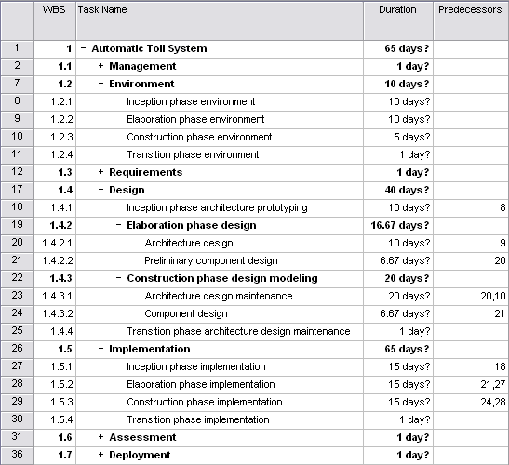
Sample evolutionary precedence table

Slide 16
Planning Project Time Management II
PERT Chart
CPM

Slide 17
What is a PERT?
Program Evaluation & Review Technique or PERT
Identify the tasks (or activities) required to complete the given project
Use the WBS
List the activities in a structured fashion, along with their interdependencies
Use a Gantt Chart
Precedence table
A "network" of the activities and their dependencies is drawn up. In MS Project, PERT is called Network Diagram
Each event may be represented by a node
Before any activity can begin, all its predecessor activities must have been completed
Notes:
PERT - short for Program Evaluation & Review Technique - is an outgrowth of research work carried out by the U.S. navy in the late 1950s, when they were trying to put the Polaris Fleet Ballistic Missile Project on schedule. There were thousands of contractors and agencies involved in this project. Earlier askance at this technique gave way to respect when the program ended two years before its scheduled completion date.

Slide 18
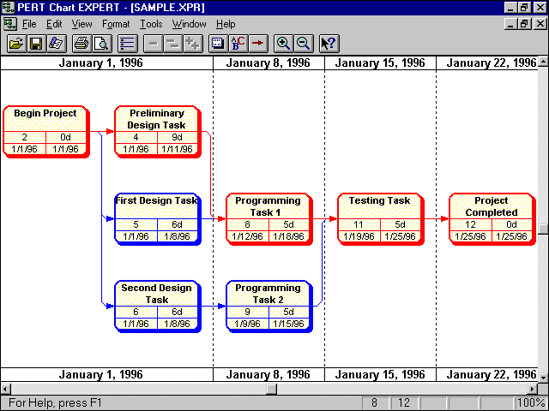
Program Evaluation and Review Technique.
Help understand relationship between tasks and project activity flow.

Slide 19
Slack Time
Slack time, also known as float, is the amount of delay expressed in units of time that could be tolerated in the starting time or completion time of an activity without causing a delay in the completion of the project.
Slack time is the difference between the late finish and the early finish (LF-EF). If the result is greater than zero, then the activity has a range of time in which it can start and finish without delaying the project completion date, as shown in the figure below:
A
Duration
Slack
ES
EF
LF

Slide 20
Slack Time
If an activity has zero slack, it determines the project completion date. In other words, all the activities on the critical path must be done on their earliest schedule or the project completion date will suffer.
If an activity with total slack greater than zero were to be delayed beyond its late finish date, it would become a critical path activity and cause the completion date to be delayed.
The sequence of activities that has zero slack is defined as the critical path
In general, the critical path is the path that has minimum slack.

Slide 21
Critical path method
The critical path method (CPM) focuses on calculating theoretical start and finish dates for every activity in the project. In the context of the CPM, the following definitions are essential:
Critical. A critical activity or event is one that must be achieved by a certain time; a critical activity has no latitude (slack or float)
Critical path. The critical path is the longest path through a project network. Because it has no slack, all activities on the critical path must be completed as scheduled, or the end date will slip
CPM performs these calculation without regard for resource limitations, which can lead to resource over-allocation or inefficient multitasking

Slide 22
Critical path method
A forward pass analysis performs schedule calculations that identify the early start and ﬁnish dates of activities and the project
A backward pass analysis performs schedule calculations that identify the late start and ﬁnish dates of activities and the project, as well as total and free ﬂoat
Total ﬂoat (TF) is the amount of time an activity can be delayed without delaying the project as a whole
Free ﬂoat (FF) is the amount of time an activity can be delayed without delaying its successor (dependent) activities
Note that total ﬂoat is global to the project, while free ﬂoat is local to the neighborhood of the activity
See Appendix: CPM Details and Example for more details and a worked example of CPM calculations

Slide 23
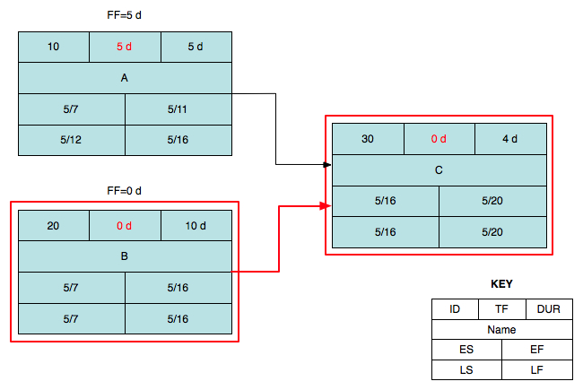
Simple critical path example
Critical Path

Slide 24
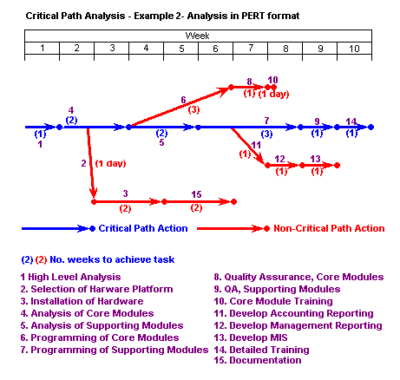
Carrying out the example critical path analysis above shows us:
That if all goes well the project can be completed in 10 weeks
That if we want to complete the task as rapidly as possible, we need:
1 analyst for the first 5 weeks
1 programmer for 6 weeks starting week 4
1 programmer for 3 weeks starting week 6
Quality assurance for weeks 7 and 9
Hardware to be installed by the end of week 7
That the critical path is the path for development and installation of supporting modules
That hardware installation is a low priority task as long as it is completed by the end of week 7

Slide 25
Project Planning Tools
Gantt Chart

Slide 26
What is a Gantt chart?
A Gantt Chart (named for Henry Laurence Gantt) consists of a table of project task information and a bar chart that graphically displays project schedule, depicting progress in relation to time and often used in planning and tracking a project.
Horizontal bar chart format, with bars representing the phases and activities of the WBS
Time extends along the horizontal axis
Able to show planned and actual progress on tasks as well as task dependencies
Effective communication tool but with limitations
Very low information density: lots of wasted space
Not very useful for large projects
Notes:
Henry Gantt (1861-1919), a mechanical engineer, management consultant, and industrial advisor developed Gantt charts in the 1910's. Not as commonplace as they are today, Gantt charts were innovative and new during the 1920's, where Gantt charts were used on large construction projects like the Hoover Dam started in 1931 and the Eisenhower National Defense Interstate Highway System started in 1956.

Slide 27
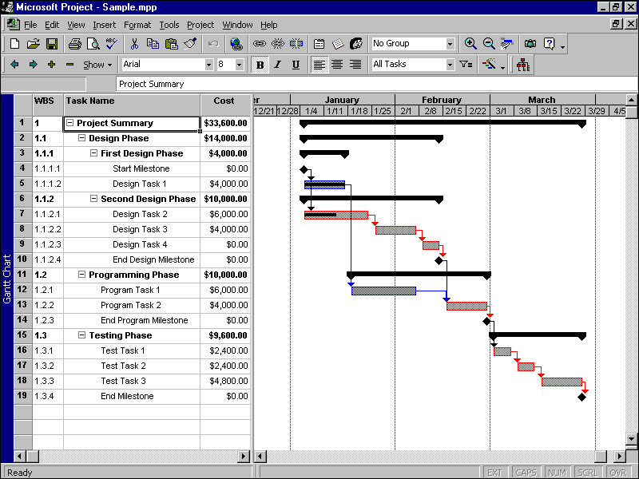
GANTT Schedule
View Project in Context of time.
Critical for monitoring a schedule.
Granularity 1 –2 weeks.
2 week window approach

Slide 28
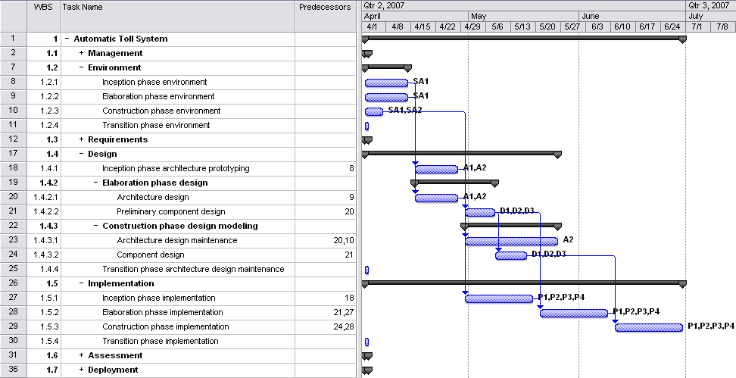
Sample evolutionary Gantt chart

Slide 29
Gantt Example:
Suppose a project comprises five activities: A,B,C,D, and E. A and B have no preceding activities, but activity C requires that activity B must be completed before it can begin. Activity D cannot start until both activities A and B are complete. Activity E requires activities A and C to be completed before it can start. If the activity times are A: 9 days; B: 3 days; C: 9 days; D: 5 days; and E: 4 days, determine the shortest time necessary to complete this project.
Identify those activities which are critical in terms of completing the project in the shortest possible time. [Critical path ]
 | 1 | 2 | 3 | 4 | 5 | 6 | 7 | 8 | 9 | 10 | 11 | 12 | 13 | 14 | 15 | 16 | 17 | 18
A
B
C
D
E
Time is 16 days
Critical path is B, C, E

Slide 30
Critical chain method
The critical chain method (CCM) focuses on the resources required for project activities, attempting to keep them leveled throughout the project
CPM scheduling is rigid and brittle: most activities have little or no ﬂoat, while the critical path, by deﬁnition, has no ﬂoat whatsoever— any delay in a critical path activity leads to a project delay
CCM, by contrast, assumes that all activities have a statistically-probable range of durations and uses this assumption to create a more ﬂexible and resilient schedule

Slide 31
Critical chain method
Each activity is assigned two durations: a ‘most likely’ or ‘best guess’ duration and a ‘pessimistic’ or ‘safe’ duration
The most likely duration represents the time it would take to complete the activity 50% of the time;
half of the time it would take less time, half of the time it would take more time
The pessimistic duration represents the time it would take to complete the activity 90% of the time;
90% of the time it would take less time, only 10% of the time it would take more time
Resources are assigned to the activities using the most likely durations
The longest sequence of activities in the project is called the critical chain

Slide 32
Critical chain method
The pessimistic time ‘surpluses’ of all activity durations in the critical chain are summed together to create a buffer that is placed at the end of the project, the project buffer
The pessimistic time surplus of an activity is the difference between the 50% (most likely) duration of the activity and the 90% (pessimistic) duration
Example: For an activity with a 50% duration of 5 days and a 90% duration of 9 days, the pessimistic time surplus is 4 days
All sequences of activities that feed into the critical chain have buffers (feeding buffers) placed at the points that they join the critical chain
During execution, project resources focus on completing the current activity within the 50% duration and avoiding multitasking
CCM project management focuses on monitoring and controlling buffer usage rather than on monitoring and controlling individual activity completion dates

Slide 33
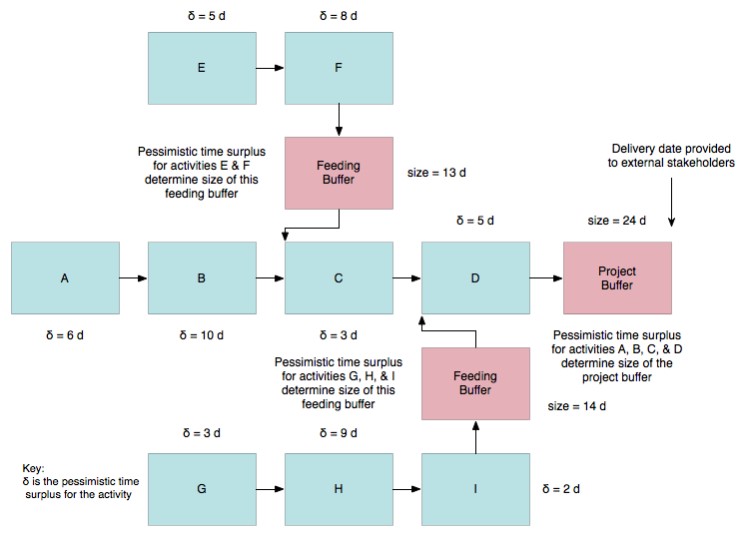
Critical chain method

Slide 34
What-if analysis
Scenario-based analysis of schedule to determine effects of various scenarios on different aspects of the project
Example: Delay delivery of a critical component by various amounts to determine effect on schedule
Example: COTS supplier is unable to provide a critical component at all
What-if scenario analysis effectively tests the robustness of the project schedule in response to adverse circumstances
Most common technique uses Monte Carlo analysis to generate a population of possible project schedule outcomes
Think of executing the same project 10,000 times with the same resources, different boundary conditions, and no memory between executions
Very useful in preparing contingency and response plans for project risks (to be discussed in upcoming lecture)

Slide 35
Resource leveling
Resource leveling is applied to a schedule analyzed by CPM
Addresses situation where resource availability is constrained by time or amount of the resource available
May also be used to keep resource usage at a constant level during certain time periods in the project
Resource leveling is needed when resources have been over-allocated or assigned to two or more activities in the same time period
May change the critical path in the schedule model
Beware of automated resource leveling—the project schedule network may be nearly unrecognizable after leveling

Slide 36
Resource leveling
Uses a number of different approaches, including:
Assign under-allocated resources to multiple tasks to keep them busy
Move key resources off of non-critical tasks
Delay start of task until required resources are available, possibly using lags
Split tasks into two or more subtasks so the subtasks can be assigned to different resources

Slide 37
Keeping a sense of perspective
Project management is not just scheduling.
(Though sometimes it seems that way.)

Slide 38
Applying leads and lags
Applying leads and lags allows refinement of a schedule once the major schedule network analysis effort has been completed
Use of leads and lags may be used to meet imposed constraints, help in resource leveling, or incorporate contingency reserves into a schedule

Slide 39
Calendars
Identify days and dates when work can be performed
Affect all project-related activities
General project calendars govern overall limitations on when project work may be performed
Example: Work is performed at a client site, and the client shuts down for three weeks during the summer
Resource calendars govern limitations on when particular resources (or resource groups) may perform project work
Example: Individual project team member vacation schedules
Example: Development team training schedules

Slide 40
Schedule development output
Project schedule network diagrams
Show both project network logic (sequencing) as well as critical path schedule activities
Usually displayed as an activity-on-node diagram
Gantt charts
Specialized bar charts format to show activity start and end dates, along with durations
Easy to read but limited by low information density
Milestone charts
‘Stripped-down’ version of Gantt chart, showing only milestones

Slide 41
Reducing Project Duration
How can you shorten the schedule?
Via
Reducing scope (or quality)
Adding resources
Concurrency (perform tasks in parallel)
Substitution of activities

Slide 42
Schedule compression
Shortens the project schedule without changing the project scope, to meet schedule constraints, imposed dates, or other schedule objectives
There are two types of schedule compression, crashing and fast-tracking
Crashing. Analyzes cost and schedule trade-offs to get the greatest amount of compression with the least cost
Examples: Use of additional resources, being more efficient, changing approach used to perform work, work overtime
Schedule crashing only works for activities where additional resources may shorten the duration of the activity

Slide 43
Schedule compression
Fast-tracking. Activities that would normally be done sequentially are done in parallel.
Fast-tracking can lead to rework and increased risks due to unforeseen dependencies
Fast-tracking only works when activities can be overlapped to shorten the total duration

Slide 44
Compression Techniques
Shorten the overall duration of the project
Crashing
Looks at cost and schedule tradeoffs
Gain greatest compression with least cost
Add resources to critical path tasks
Limit or reduce requirements (scope)
Changing the sequence of tasks
Fast Tracking
Overlapping of phases, activities or tasks that would otherwise be sequential
Involves some risk
May cause rework
Barry Boehm says you cannot compress more than 25%

Slide 45
Task
Name
ID
Description of work
Duration (days)
Start Date (Earliest, Latest)
Finish Date (Earliest, Latest)
Resources (People and equipment)
Effort (In staff-days)
Predecessors (other tasks)
Inputs (documents, decisions, information)
Successors (other tasks)
Outputs (documents, decisions, information)

Slide 46
Mythical Man-Month
Book: “The Mythical Man-Month”
Author: Fred Brooks
“The classic book on the human elements of software engineering”
First two chapters are full of terrific insight (and quotes)
Sample Quotes
“Cost varies as product of men and months, progress does not.”
“Hence the man-month as a unit for measuring the size of job is a dangerous and deceptive myth”
Notes:
Software is a ‘systems effort’

Slide 47
Mythical Man-Month
Why is software project disaster so common?
Estimation techniques are poor & assume things will go well (an ‘unvoiced’ assumption)
Estimation techniques fallaciously confuse effort with progress, hiding the assumption that men and months are interchangeable
Because of estimation uncertainty, manager lack courteous stubbornness
Schedule progress is poorly monitored
When schedule slippage is recognized, the natural response is to add manpower. Which, is like dousing a fire with gasoline.

Slide 48
Mythical Man-Month
Optimism
“All programmers are optimists”
1st false assumption: “all will go well” or “each task takes only as long as it ‘ought’ to take”
The Fix: Consider the larger probabilities
Cost (overhead) of communication (and training)
His formula: n(n-1)/2
How long does a 12 month project take?
1 person: 12 months
2 persons = 7 months (2 man-months extra)
3 persons = 5 months (3 man-months extra)
Fix: don't assume adding people will solve the problem

Slide 49
Mythical Man-Month
Sequential nature of the process
“The bearing of a child takes nine months, no matter how many women are assigned”
What is the most mis-scheduled part of process?
Testing (the most linear process)
Why is this particularly bad?
Occurs late in process and w/o warning
Higher costs: primary and secondary
Fix: Allocate more test time
Understand task dependencies
Notes:
He advocates 50% of schedule to Test
Late
Highest cost: most staffed time
Changes cost more
Secondary costs
You need to understand Critical Path and other dependencies

Slide 50
Mythical Man-Month
Reliance on hunches and guesses
What is ‘gutless estimating’?
The myth of additional manpower
Brooks Law: “Adding manpower to a late project makes it later”
Q: “How does a project get to be a year late”?
A: “One day at a time”
Studies
Each task: twice as long as estimated
Only 50% of work week was programming
Fixes
No “fuzzy” milestones (get the “true” status)
Reduce the role of conflict
Identify the “true status”
Notes:
omelet and chef analogy
what does Brooks mean by this?
Termites not tornadoes
Imperceptibly but inexorably
Hard to recognize
Reduce conflict: status vs. action meetings

Slide 51
Schedule Development Workflow and Example

Slide 52
Scheduling workflow
Define activities
Use of WBS template helps guide definition process and organize activities
Perform activity sequencing
Develop schedule framework according to what is logically possible – perform resource allocation later
Estimate effort – the total number of labor units (e.g. staff-days) for each activity
Identify resources for each activity
Apply calendars to schedule framework

Slide 53
Scheduling workflow
Estimate activity duration based on resources for activity
Perform forward pass or backward pass critical path analysis to generate schedule model
Perform ‘what-if’ scenario analysis to identify contingency and risk response needs
Apply resource leveling to schedule model
Apply schedule compression, if needed

Slide 54
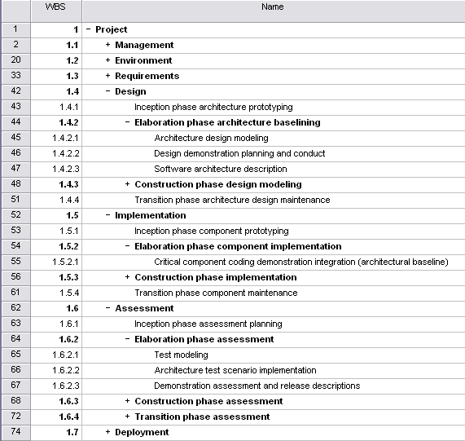
WBS template
Component groups with a ‘+’ in front of them are ‘rolled up’ – subcomponents are hidden to reduce clutter

Slide 55
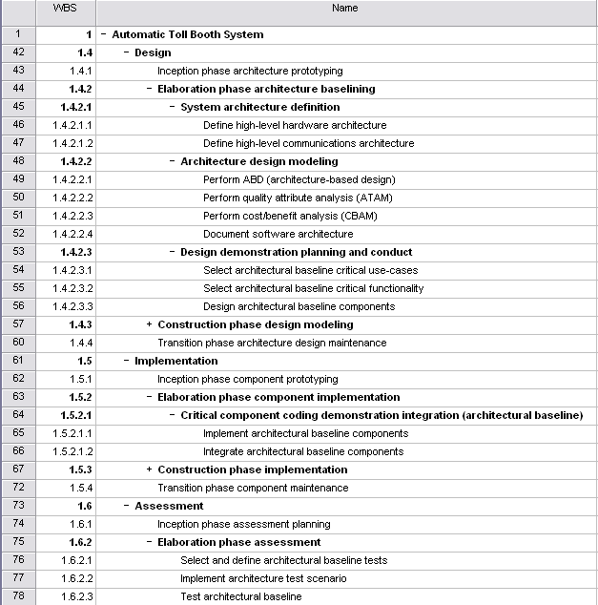
Activity definition
Added System architecture definition WBS component
Note expansion and detailing of WBS template Architecture design modeling entry; renamed Software architecture description to Document software architecture
Note expansion and detailing of WBS template Design demonstration planning and conduct entry
Note rework of WBS template Elaboration phase assessment entry
Note expansion and detailing of WBS template Critical component coding demo integration entry

Slide 56
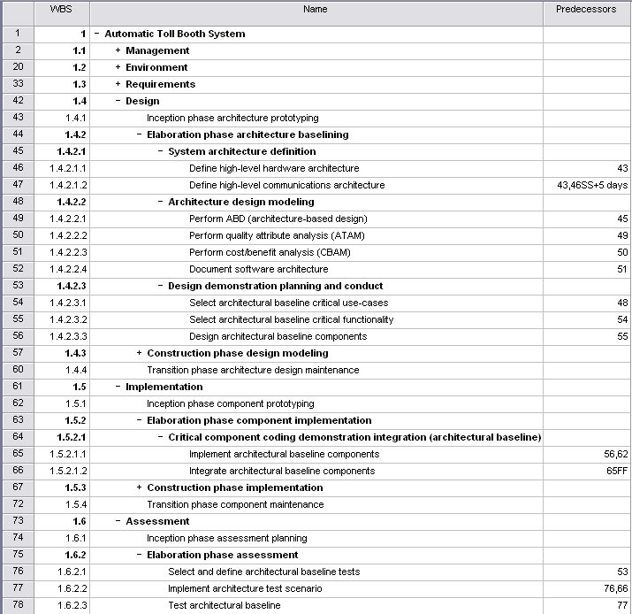
Activity sequencing
Note dual predecessors.
Default relationship is Finish-to-Start. Here, we have defined a Start-to-Start relationship with an added lag of 5 days
Here, we have defined a Finish-to-Finish relationship: this is common for implementation/integration task pairs

Slide 57
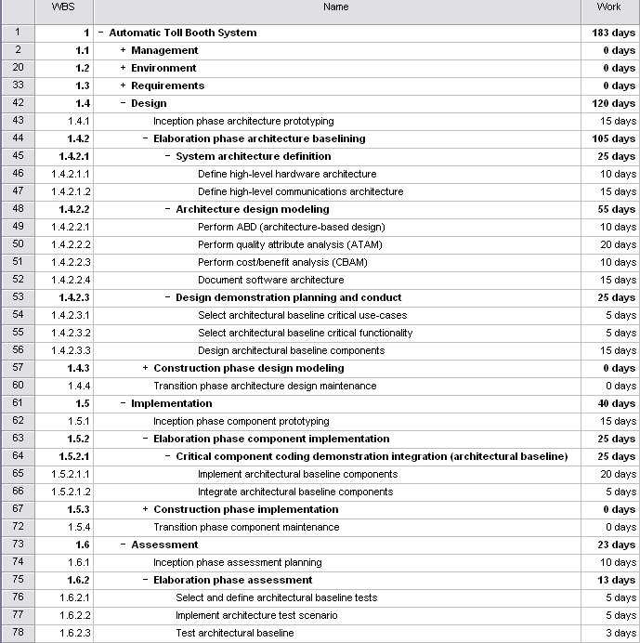
Effort Estimation
Effort (called work in MS Project) is the total number of labor units needed to complete a task
Measured in staff units (-hours, -days, -weeks, etc.)
Effort allocated among resources provides duration estimates

Slide 58
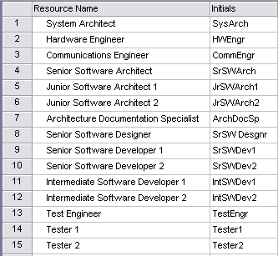
Activity resource estimating
Walk through activities and identify classes of resources needed
If possible, do not specify individuals at this point, only their role/title
Identify specific individuals as resources only if necessary

Slide 59
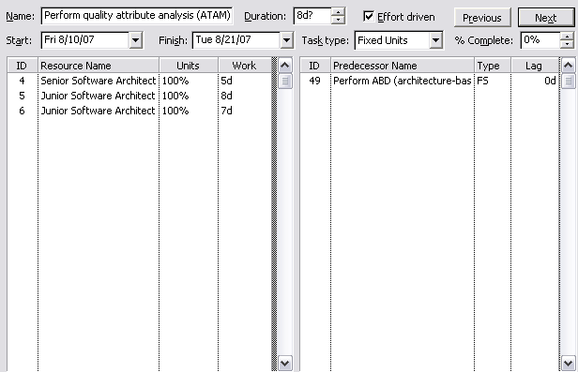
Duration estimation
The effort estimated in the effort estimation step is the total labor units needed to complete a task
Duration estimation results from taking the effort and distributing it among the resources for task

Slide 60
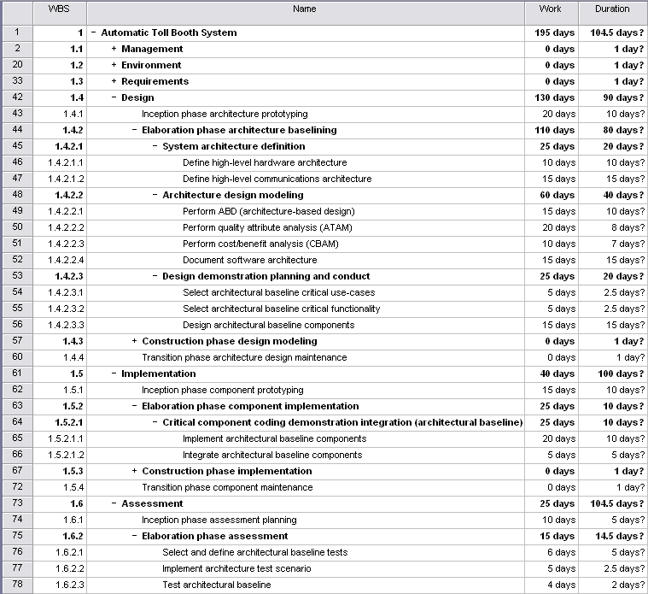
Duration estimation
The resource allocation for this task is detailed on the preceding slide. Note the 20 day work (effort) estimate vs. the 8 day duration
Long durations for these summary components are due to incomplete data entry for all subcomponents

Slide 61
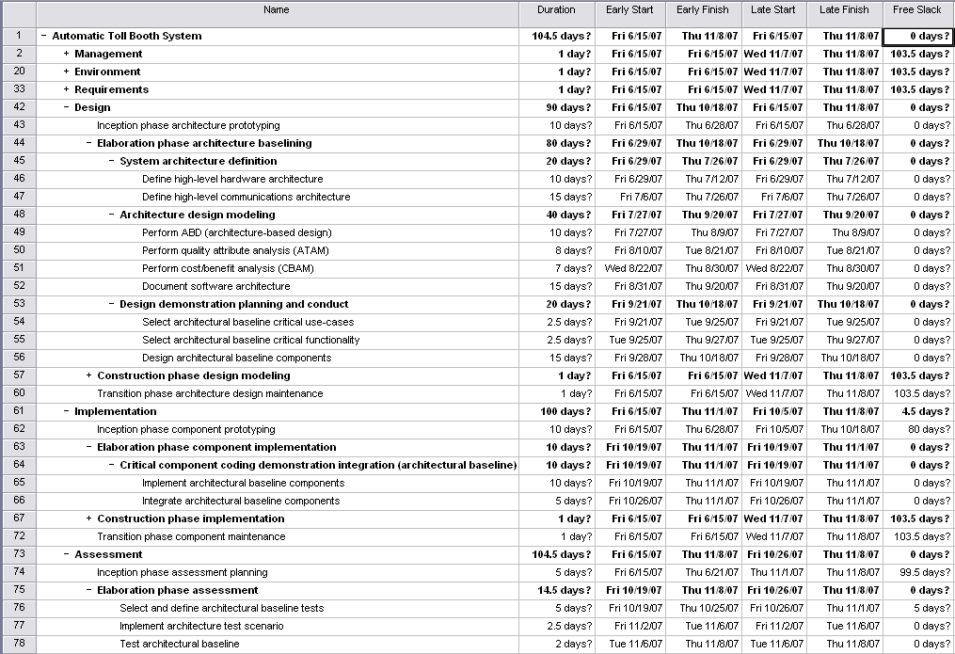
Critical path: early/late start and finish with float (slack)

Slide 62
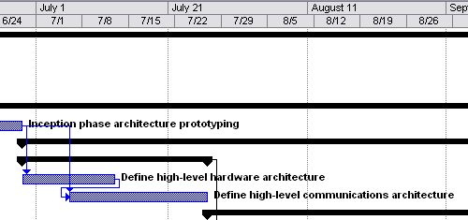
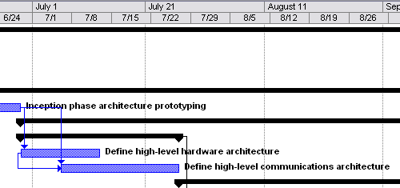
Schedule compression
Use Finish-to-Start dependency with 5 day negative lag (-5) for successor to get reasonable relationship between two tasks. Equivalent to a 5 day lead for successor
Alternatively:
Use Start-to-Start dependency with 5 day lag for successor to get reasonable relationship between two tasks
Note schedule compression of 5 days

Slide 63
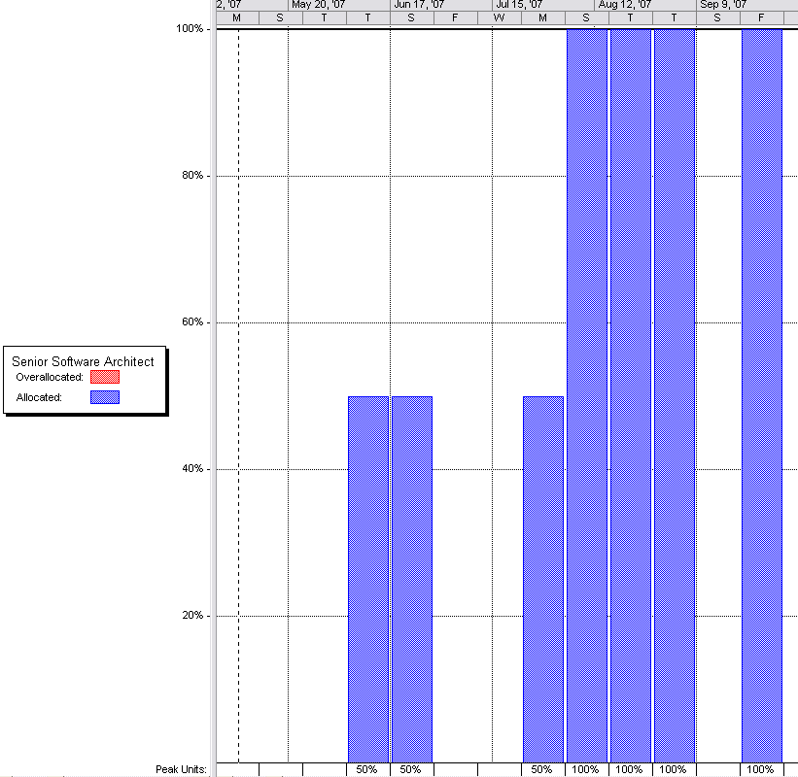
Determining resource utilization
Resource graphs show the utilization of individual resources as a function of time
Resource graphs can be used to identify over- and under-utilized resources
Resource leveling can be used to balance utilization and/or to shift tasks to lower-cost resources

Slide 64
Next Class
Topic:
Risk Management: Planning, risk identification, quantification and prioritization; Risk analysis, response planning, avoidance, mitigation, monitoring.
Reading:
PMBOK-SWE Ch. 11 Intro & Ch. 11.1-11.6
Assignment 3 – due February 8
Notes:
Lecture 1
January 8, 2008
SE 425
64/108

Slide 65
Journal Exercises
Read the paper: Programmer Productivity: The "Tenfinity Factor” <http://www.devtopics.com/programmer-productivity-the-tenfinity-factor/>
Comment.
Given the above, what about the impact on estimating?
Also, think about programmer style and lines of code measurements.
Notes:
SE 425
April 3, 2008
Lecture 1
65/85
SE 425
April 3, 2008
Lecture 1
65/108
Lecture 1
January 8, 2008
SE 425
65/108

Slide 66

Midterm Examination
“Nobody expects the Spanish Inquisition!”
– Monty Python
Notes:
This is from a famous sketch by Monty Python, a British comedy troop and show.

Slide 67
Mid-term Examination
Midterm Examination will be on the Desire2Learn system starting Friday, February 3, through Tuesday, February 7
See important information about Taking Quizzes On-line
Login to the Desire2Learn System (https://d2l.depaul.edu/)
Take the Mid-term examination.
It will be made available Friday, February 3, 2017.
You must take the exam by COB Tuesday, February 7.
Allow 3 hours (should take about one hour if you are prepared); note: books or notes should not be used.
Midterm study guide [note solution to some problems on last page].
Notes:
Taking Quizzes on-line
There are a couple of things for the students to keep in mind when taking a quiz on-line. When taking the quiz, once started the student may not click or select any area outside of the quiz page. During the quiz the ISP will not receive any indication of user activity. Some ISPs will terminate the session due to inactivity. This would only be a problem for lengthy quizzes.
The test may present each question one at a time. It will save each answer before going to the next question. You may return to a question and revise the answer but once you press submit you may not revisit the test.
You will be warned if you do not answer a question fully or if you did not answer a question at all.
In writing answers with multiple responses please mark or number each response and separate them by a couple of blank lines.
Read each question carefully. Note especially words in bold as they signify something special about the context of the question. Also, note whether we are asking for the correct answer or the incorrect answer.

Slide 68
SE 477 – Class 5: Appendices
This is material that is relevant but not used often enough to present in the main part of the class.
Topics:
Scheduling
PERT Estimation technique
Critical Path Method (CPM)
Forward and backward pass analysis
Calculating float

Slide 69
Appendix: PERT Estimation Technique

Slide 70
PERT estimation technique
Most widely used three-point estimate is PERT (Program Evaluation and Review Technique)
Defines three estimate points as:
Most likely: estimate that occurs with greatest frequency
Optimistic: shortest duration, taken as 10th percentile value
Pessimistic: longest duration, taken as 90th percentile value
PERT activity duration estimate T_{E} and its standard deviation (s_{E} or σ) are calculated according to:

Slide 71
Duration estimates distribution
Most Likely Estimate is peak of distribution. For symmetric distributions, Most Likely Estimate and mean coincide. However, for skewed distributions the peak will be shifted off-center and differ from the mean.
Optimistic Estimate
For this activity,
only 10% of the time activity will take less time than this. Conversely, 90% of the time activity will take more time than this.
Pessimistic Estimate
For this activity,
90% of the time activity will take less time than this. Conversely, only 10% of the time activity will take more time than this.
Note that this is a symmetric, continuous distribution.
Actual data will be discrete, will likely be skewed,
and will best be displayed in a histogram.
10th
Percentile
~ μ -2.24σ
μ
90th
Percentile
~ μ +2.24σ
Duration

Slide 72
How to calculate PERT estimates
This is for statistics majors and rarely used except when analyzing data.
Calculate the sample mean:
Calculate the sample standard deviation:
Use Chebyshev's rule to approximate optimistic and pessimistic estimates:
At least (1 − 1/k²) · 100% of the values are within k standard deviations from the mean
So, solving for k when this equation equals 80% (for the 20% outside the 10 and 90 percentiles), we get approximately:

Slide 73
PERT calculation example
You have the following estimates for an activity, in staff-hours: 24, 24, 24, 40, 48, 48
Calculate the sample mean:
Calculate the sample standard deviation (s or σ):

Slide 74
PERT calculation example
Now, calculate the PERT estimates :
Finally, the PERT estimated activity duration is:

Slide 75
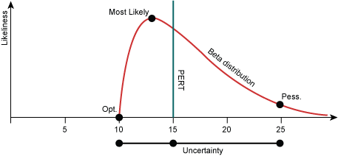
PERT calculation
Beta Distribution
See Journal exercise

Slide 76
Journal Exercises
Think about the problems with getting a good estimate.
The PERT and three point estimations all rely on the assumption that the distribution of estimates are Gaussian in nature. What if they are not? What if there is a large tail for pessimistic?
Hint: lookup Beta Distributions:
Hint: Better Project Management Through Beta Distribution http://www.isixsigma.com/methodology/project-management/better-project-management-through-beta-distribution/
Notes:
SE 425
April 3, 2008
Lecture 1
76/85
SE 425
April 3, 2008
Lecture 1
76/108
Lecture 1
January 8, 2008
SE 425
76/108

Slide 77
Appendix: CPM Details and Example

Slide 78
Critical path method
A forward pass performs schedule calculations that identify the early start and finish dates of tasks and the project
A backward pass performs schedule calculations that identify the late start and finish dates of tasks and the project, as well as total and free float

Slide 79
Critical path method
A forward pass analysis performs schedule calculations that identify the early start and finish dates of activities and the project
Early Start Date (ES). ES represents the theoretically earliest date a activity can start
ES = Maximum EF of predecessor activity(-ies)
Early Finish Date (EF). EF represents the theoretically earliest date a activity can finish
EF = ES + duration of activity

Slide 80
Critical path method
A backward pass analysis performs schedule calculations that identify the late start and finish dates of activities and the project, as well as total and free float
Late Start Date (LS). LS represents the theoretically latest date a activity can start without delaying the project
LS = LF – duration of activity
Late Finish Date (LF). LF represents the theoretically latest date a activity can finish without delaying the project
LF = Minimum LS of successor activity(-ies)

Slide 81
Critical path method
Total float (TF) is the amount of time a activity can be delayed without delaying the project as a whole
TF = LF - EF
If LF < EF then TF < 0
If a project has a fixed finish date constraint then TF might be less than zero, meaning it must complete before LF to satisfy the finish date constraint
Free float (FF) is the amount of time a activity can be delayed without delaying its successor (dependent) activities
FF = Minimum ES (successor activities) – EF
Note that total float is global to the project, while free float is local to the neighborhood of the activity

Slide 82
Critical Path Method
List all activities in plan.
Plot tasks onto chart. (Tasks = arrows. End Tasks = dots)
Show dependencies.
Schedule activities
Sequential activities on critical path.
Parallel activities.
Slack time for hold-ups.
Find longest path through chart.
This is the critical path
What is the difference between critical path and critical chain?
Critical chain also manages buffer activity durations and resources

Slide 83
Performing forward pass CP analysis
ES = Maximum EF of predecessor task(s)
EF = ES + duration of task
10
TF
5 days
A
2
5/7
5/11
30
TF
4 days
1
C
5/16
5/19
4
1
20
TF
10 days
B
5/7
5/16
2
3
Key
ID
TF
DUR
Name
ES
EF
LS
LF

Slide 84
Performing backward pass CP analysis
LF = Minimum LS of successor task(s)
LS = LF – duration of task
10
TF
5 days
A
3
5/7
5/11
30
TF
4 days
5/12
5/16
C
4
5/16
5/19
4
20
TF
10 days
5/16
5/19
1
B
5/7
5/16
Key
3
2
ID
TF
DUR
5/7
5/16
Name
ES
EF
LS
LF

Slide 85
Calculating float
FF = 6
TF = LF - EF
FF = Minimum ES (successor task) – EF
10
6 days
5 days
A
5/7
5/11
30
0 days
4 days
Critical path
5/12
5/16
C
5/16
5/19
20
0 days
10 days
5/16
5/19
B
5/7
5/16
Key
5/7
5/16
ID
TF
DUR
Name
ES
EF
FF = 0
LS
LF

